Slide 1
Structure in C++

Slide 2
Introduction
An array allows us to store a collection of variables
However, the variables must be of the same type to be stored in an array
E.g. if we wanted to store personnel information like name, CNIC, address and age, all of different types then using arrays will be impractical
Structures allow us to combine variables of different types with a single name
A convenient way of grouping several pieces of related information together

Slide 3
Introduction
Structures, In addition to the primitive data types such as int, char, float, structures can have members that are other structures, arrays or pointers.
Collections of related variables (aggregates) under one name. It can contain variables of different data types

Slide 4
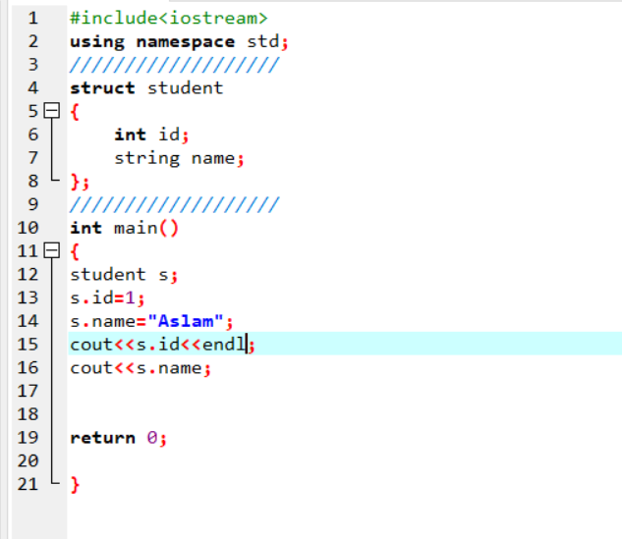

Slide 5
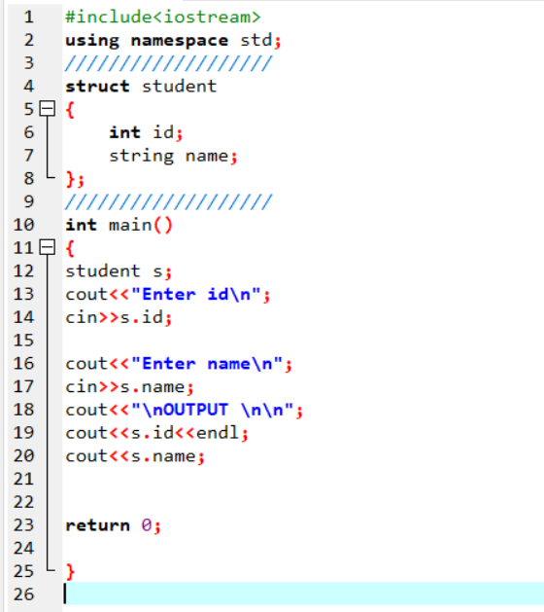

Slide 6
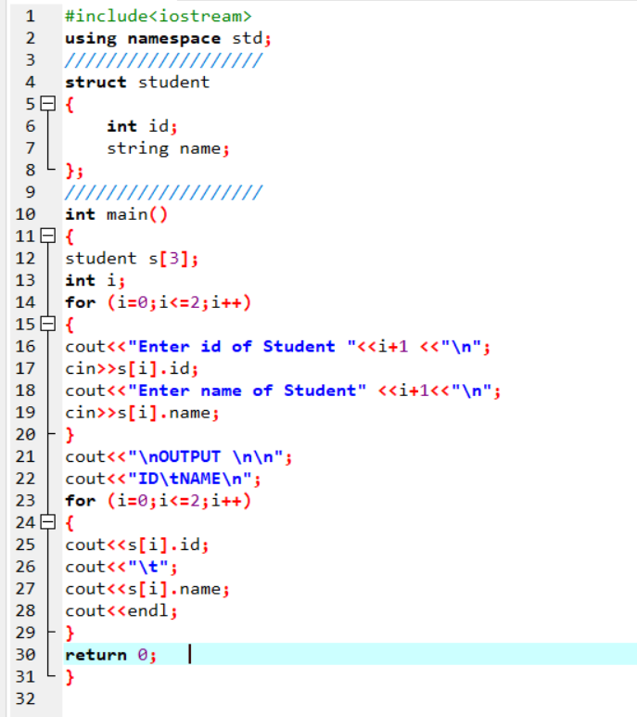

Slide 7
